Slide 1
Secure Boot on Windows 11 (Demo)
Prepared By:
Brandon Ma (30290589) Huma Naiman (30303242) Arunima Negi (30281210) Karanveer Singh (30282286)

Slide 2
How to Check if Secure Boot is Already Enabled?
Before going into the BIOS or UEFI settings, confirm if the Windows 11 Secure Boot enable process has already been completed. If so, you don’t need to do anything.
Step 1: Click on the Start button and type System Information into the search bar, then hit Enter.

Slide 3
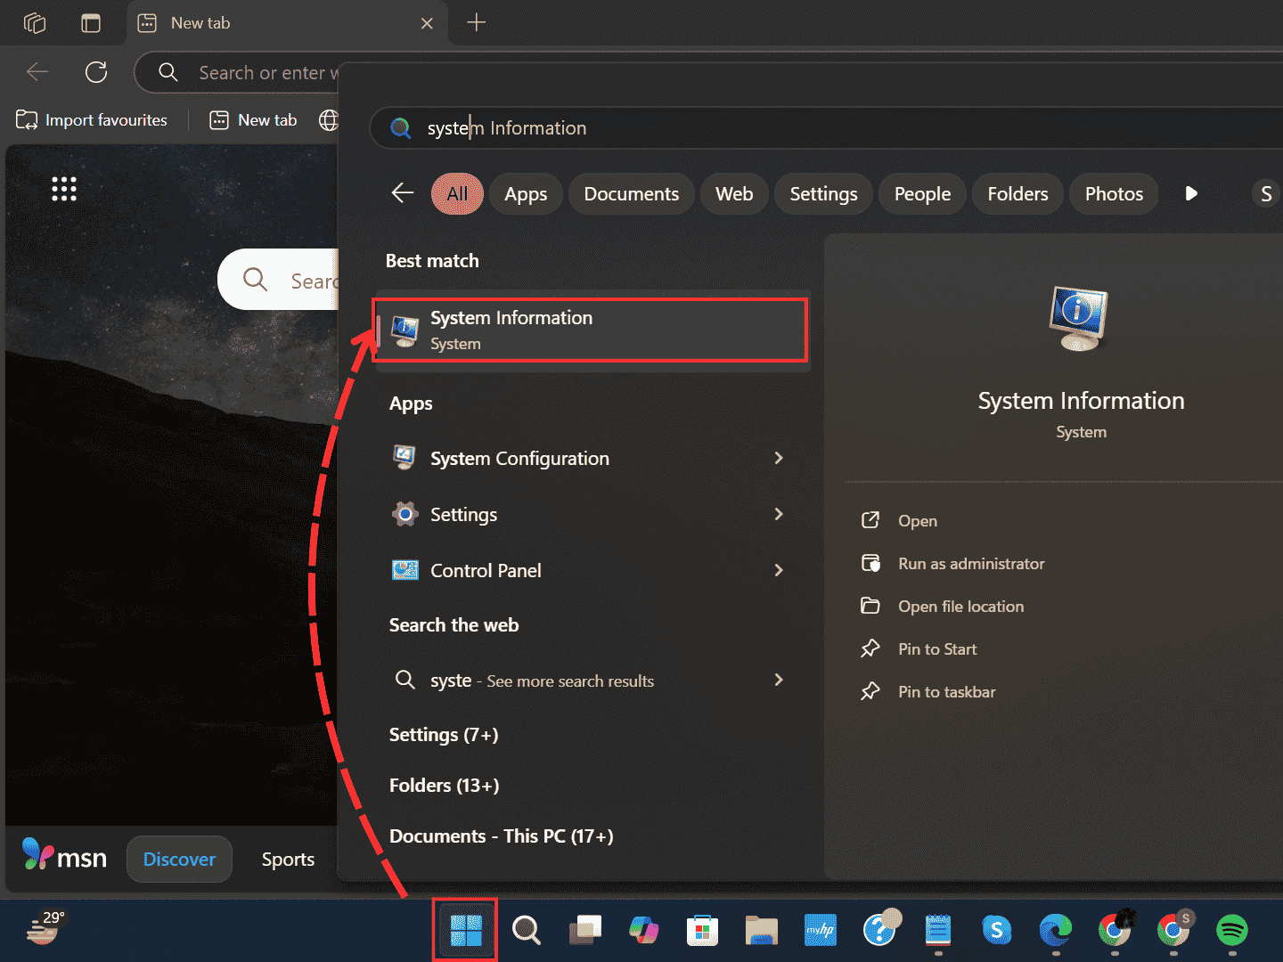
Click System Information

Slide 4
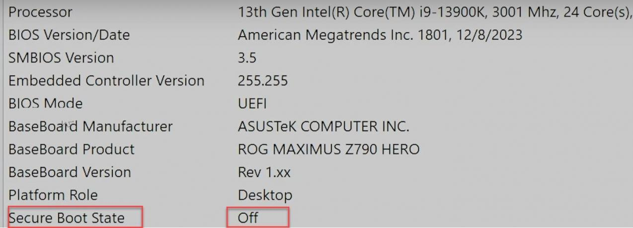
Step 2: Scroll through the System Information window list until you find Secure Boot State.
Step 3: If it says “Off”, then we will need to turn it “On”.

Slide 5
How to Enable Secure Boot?
Step 1: Press the Windows Key + I to open the Settings app. Navigate to “Windows Update”.
Step 2: Select “Advanced Options”.

Slide 6
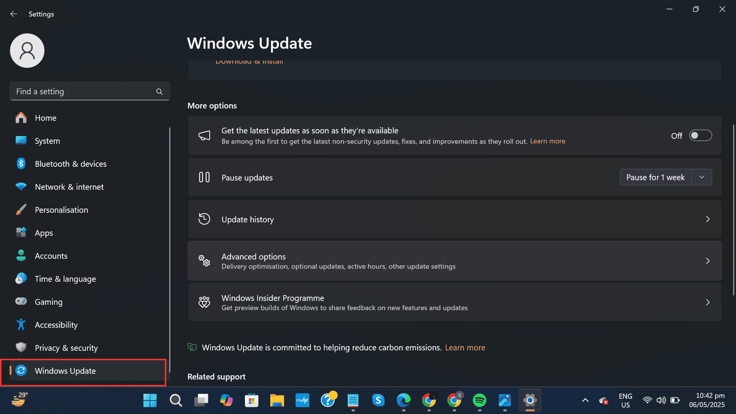
Select Windows Update

Slide 7
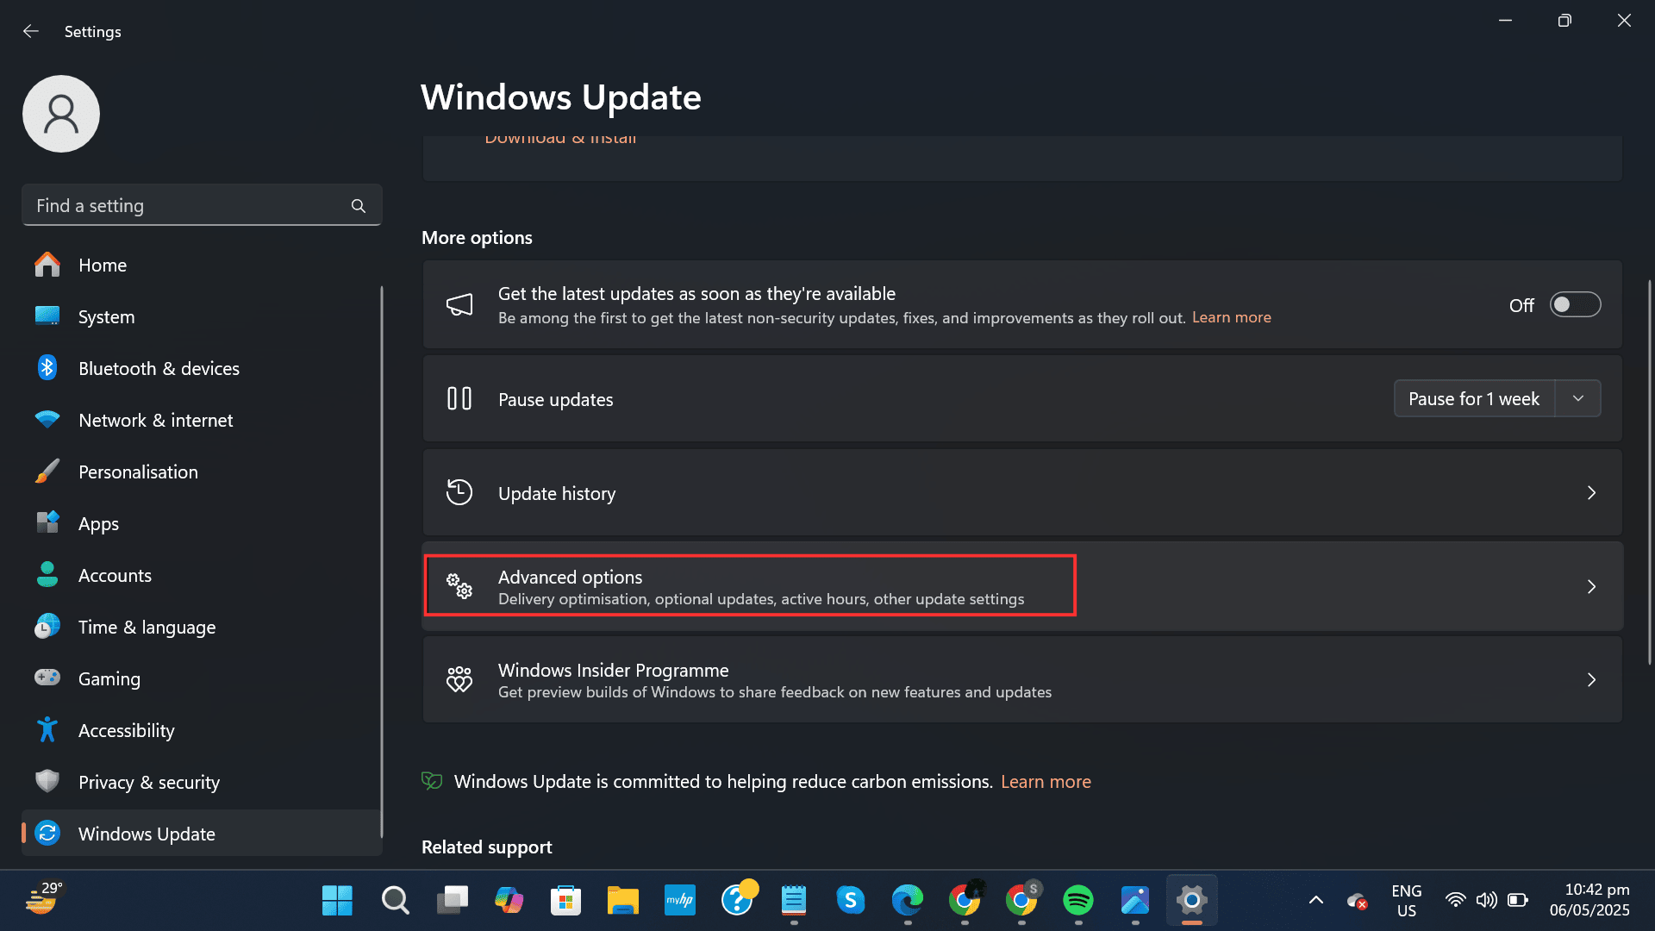
Go to Advanced Options

Slide 8
Step 3: Scroll down to the “Additional options” section. You'll see a section called “Recovery”, select it.
Step 4: Select “Restart now” under “Advanced startup”

Slide 9
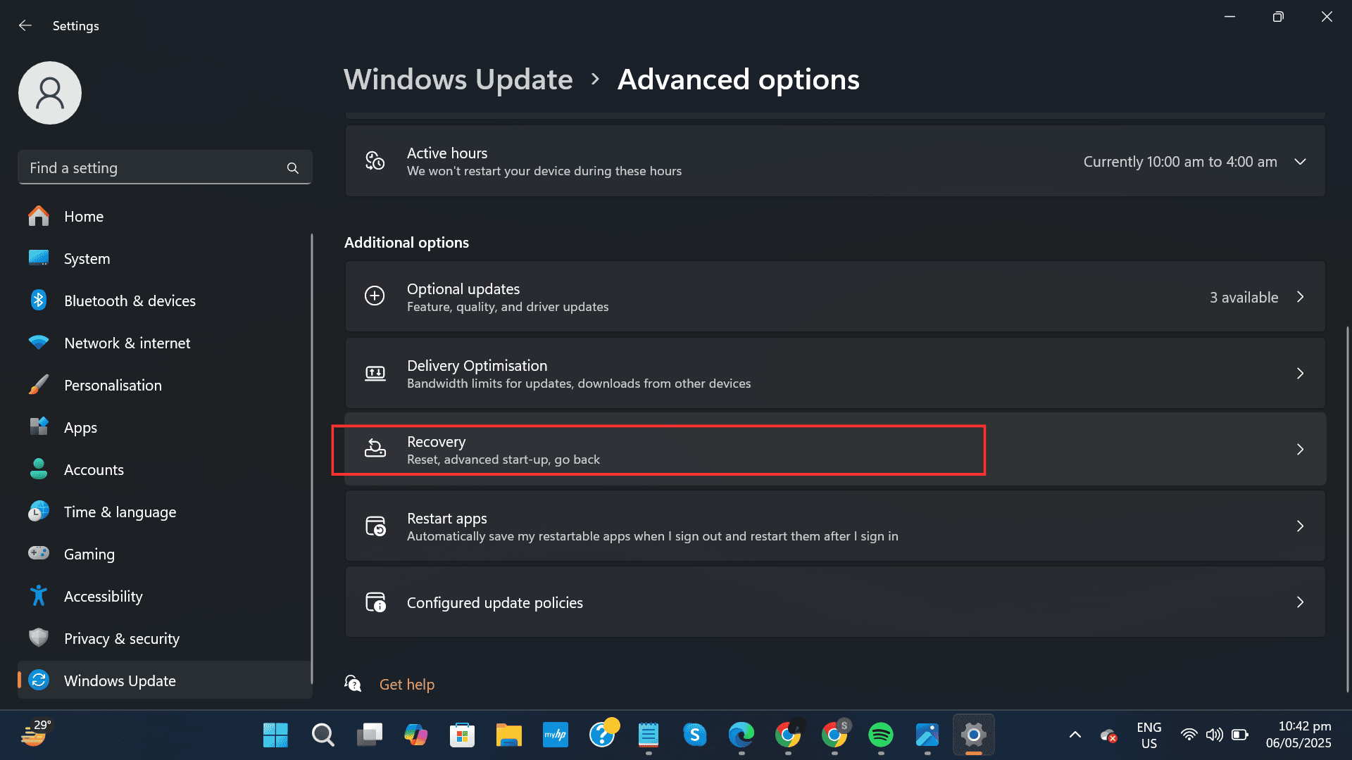
Select Recovery

Slide 10
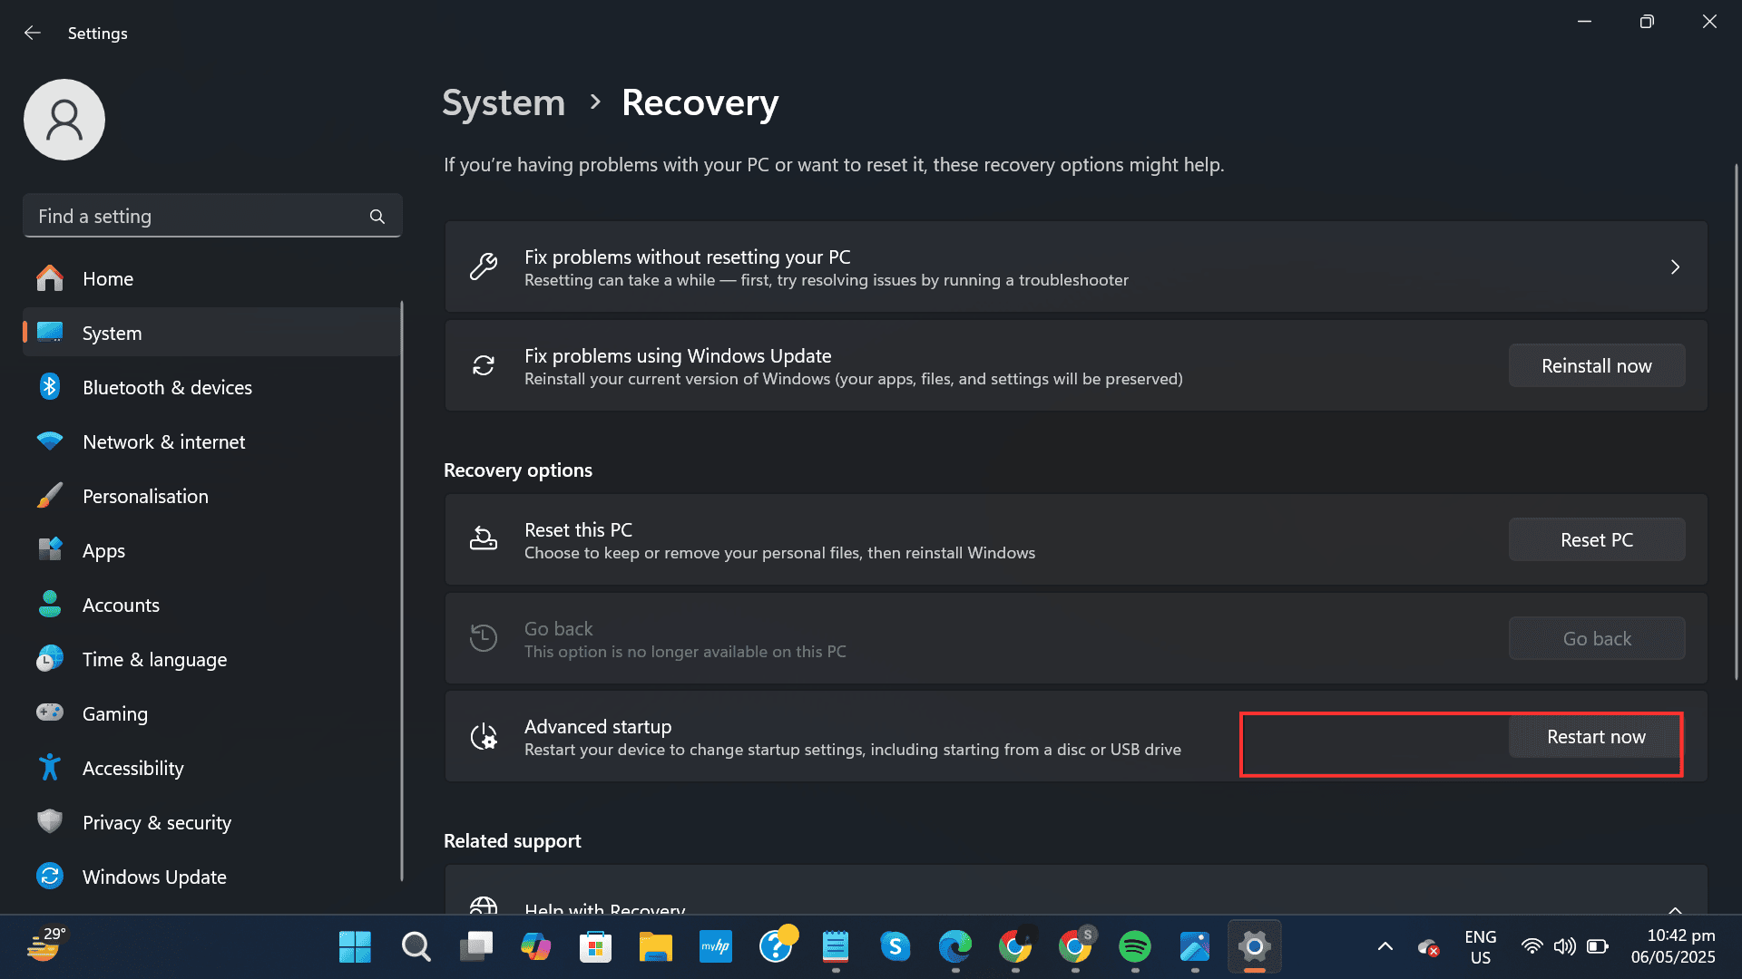
Click 'Restart' under Advanced Startup

Slide 11
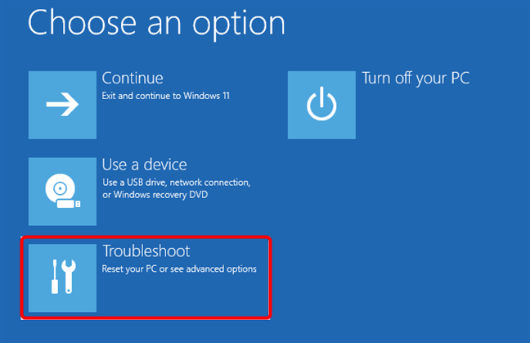
Enter UEFI Settings
Step 5: Once your PC restarts into recovery mode, select “Troubleshoot”, then head into “Advanced Options”, and select “UEFI Firmware Settings”.
Step 6: Select “Restart” one more time, and your system will boot into the UEFI where you can enable Secure Boot.

Slide 12
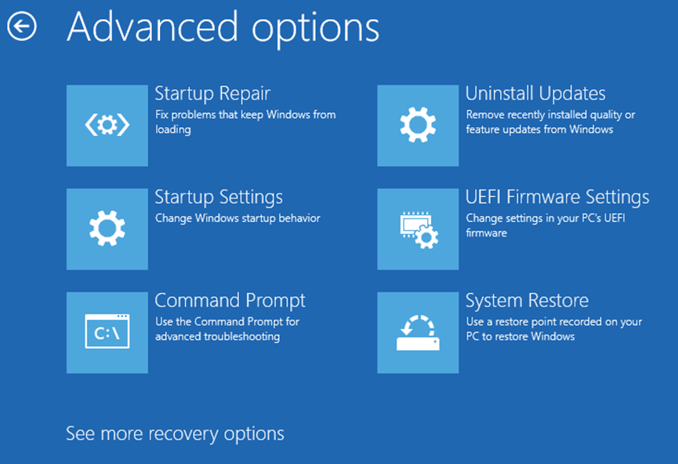

Slide 13
Alternatively, you can repeatedly press the delete key or F12 key during startup to enter UEFI directly.
Once in UEFI →
Step 1: Use the arrow keys or your mouse to move around the UEFI menu. Find and select the "Settings" or equivalent option by pressing Enter.
Note* - UEFI interface may differ from vendor to vendor. For this demo, we are using an MSI UEFI.
UEFI Menu Dashboard

Slide 14
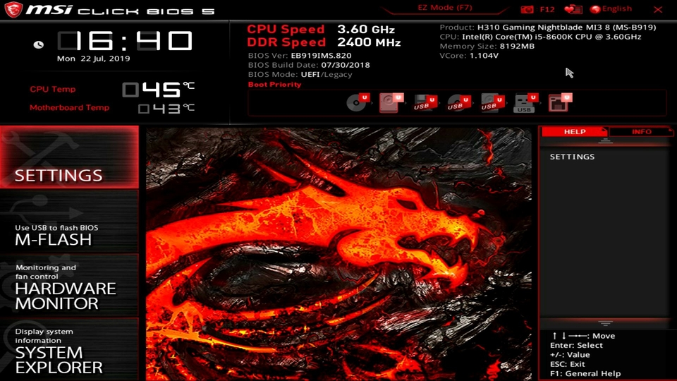

Slide 15
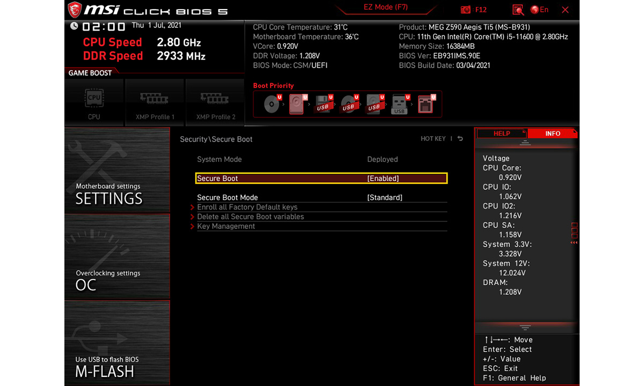
Step 2: Depending on your system, the Secure Boot settings may be under “Security” or “Advanced”. Explore these sections until you find “Secure Boot”. If you can’t locate it, search online using your motherboard model and “secure boot setting”.
Step 3: Locate the Secure Boot control option and toggle it to “enabled”.

Slide 16
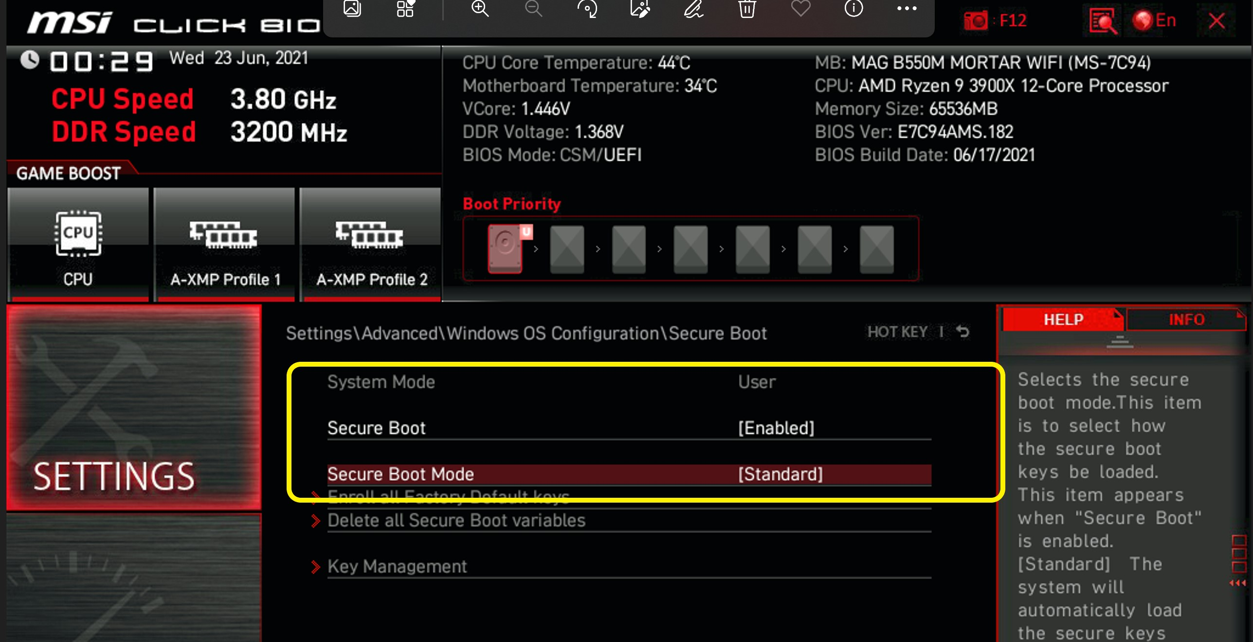
Step 4: If prompted to set the system to user mode, go to secure boot mode by selecting on it.
Step 5: Change the boot mode to “Standard”. Confirm any prompts that appear to save the change.

Slide 17
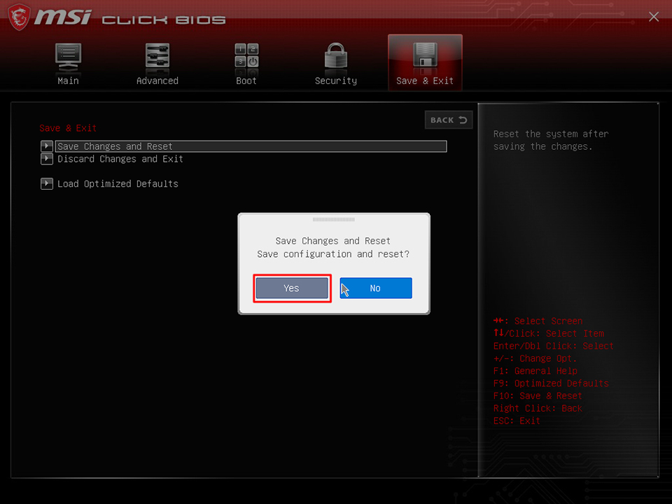
Step 6: Press Esc or use the menu to navigate to the ”Save Configuration and Exit” option. Confirm to save changes and your system will restart.
Step 7: Once back in Windows, open "System Information" by searching for it in the Start menu. Look for "Secure Boot State" to confirm it is now enabled.
Note* - If you can’t see the Secure Boot setting at all, your system might be running in Legacy mode. You’ll need to switch it to UEFI in BIOS.

Slide 18
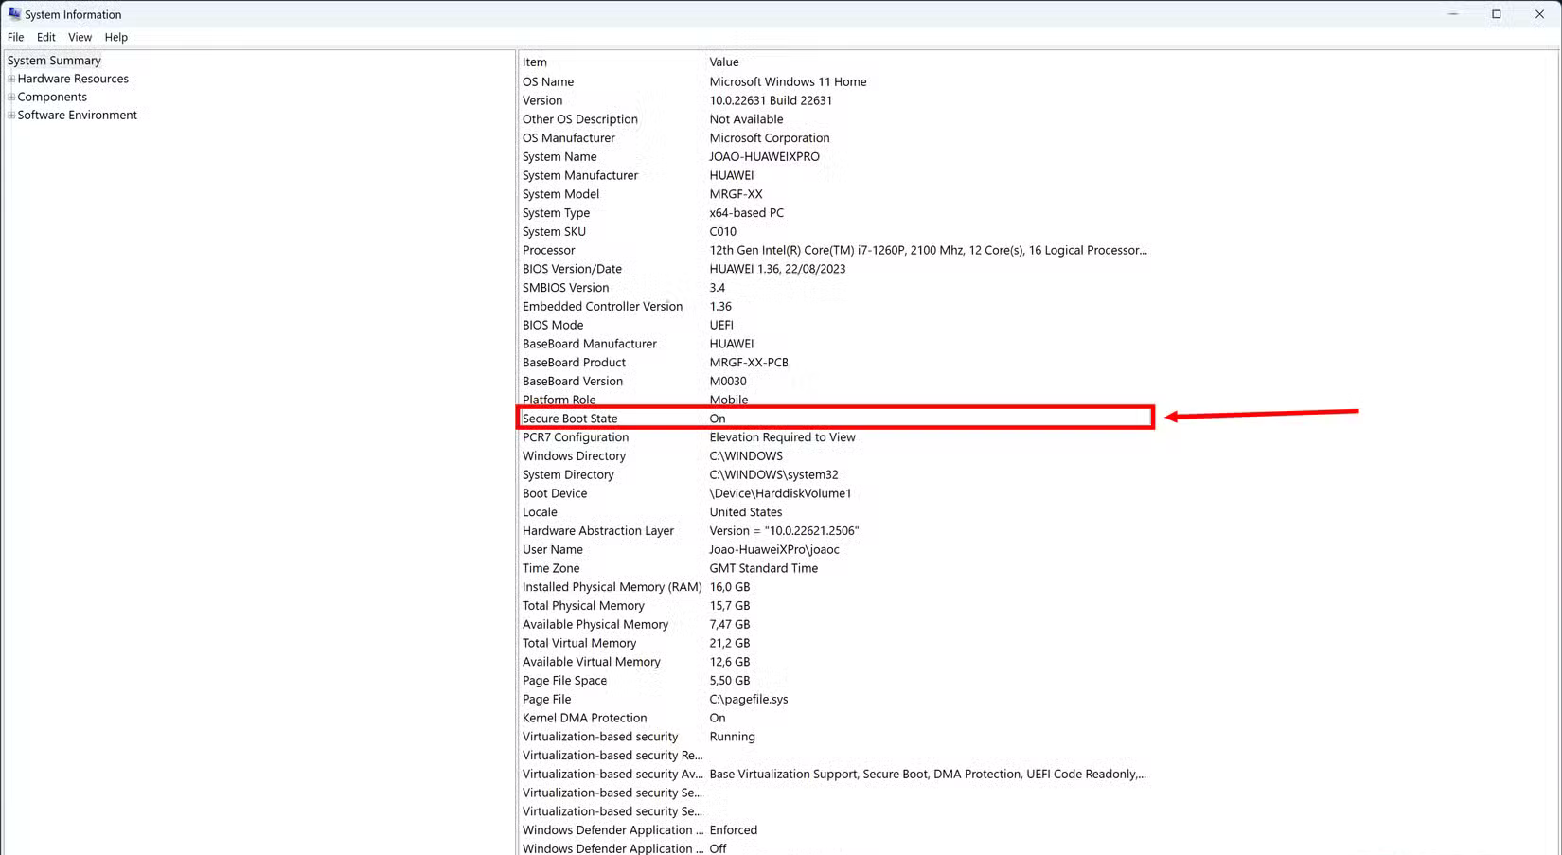
Secure Boot is now Enabled

Slide 19
How to Enable TPM 2.0 on Windows 10/11 (Demo)

Slide 20
Note*- For this demo we are using MSI UEFI. Based on your OEM, the UEFI interface may vary.
Step 1: Start/Restart your PC. While it is booting, press the manufacturer-specific key (commonly F2, F10, F12, DEL, or ESC) to enter the BIOS/UEFI settings (DEL Key for MSI BIOS).
Step 2: Use the arrow keys or your mouse to move around the UEFI. Find and select the “Settings” or equivalent option by pressing Enter.

Slide 21
Click on Settings

Slide 22
Step 3: Once inside BIOS navigate to “Settings” → “Security” → “Trusted Computing”. Find “Security Device Support” to enable TPM 2.0.
For Intel based platforms, set “TPM Device selection” to “PTT” (Intel Platform Trust Technology).
For AMD based platforms, Set “AMD fTPM” switch to “AMD CPU fTPM”.

Slide 23
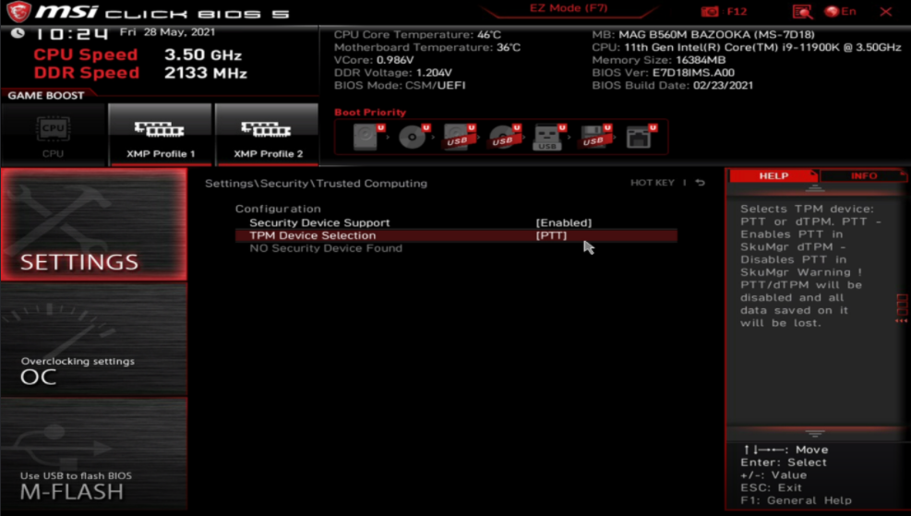
Intel Based Systems

Slide 24
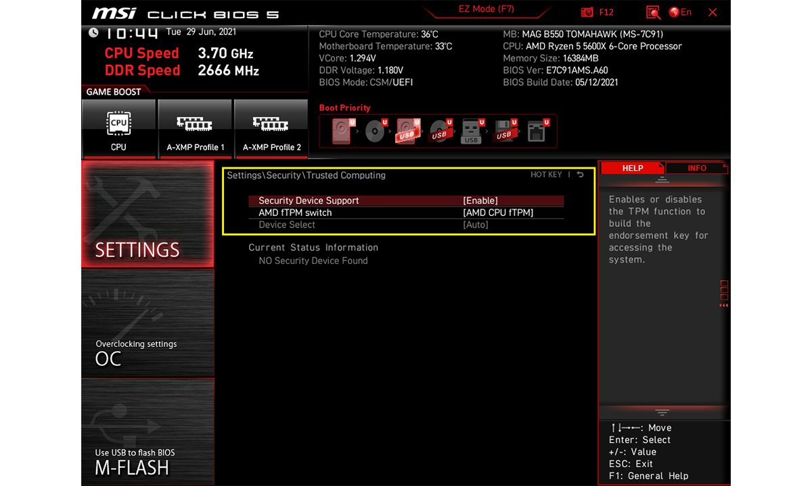
AMD Based Systems

Slide 25
Step 4: Press ESC or use the menu to navigate to the “Save Configuration and Exit” option. Confirm to save changes and your system will restart.

Slide 26
How to check TPM Status in UEFI?

Slide 27
You can check if the TPM is enabled and what the TPM version is in UEFI
Step 1: Go Back to UEFI
Step 2: Navigate to “Settings” → “Security” → “Trusted Computing”
You should see “TPM 2.0 Device Found”
Firmware Version information and vendor information.

Slide 28
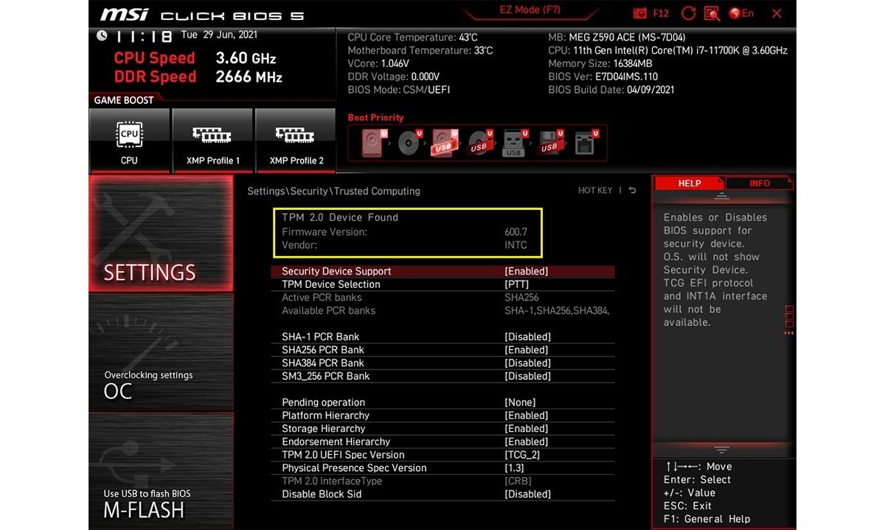
TPM 2.0 Device Found, Firmware version and vendor information

Slide 29
How to check TPM Status in Windows?

Slide 30
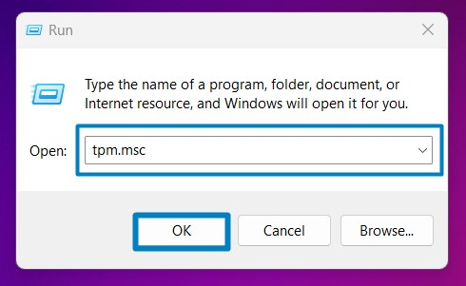
Step 1: Open Windows search and type "RUN”. Hit Enter.
Step 2: Type “tpm.msc” and hit Enter.
Step 3: The “TPM Management” interface will show the TPM version of your system.
The TPM Status Tab should show “The TPM is ready for use”.

Slide 31
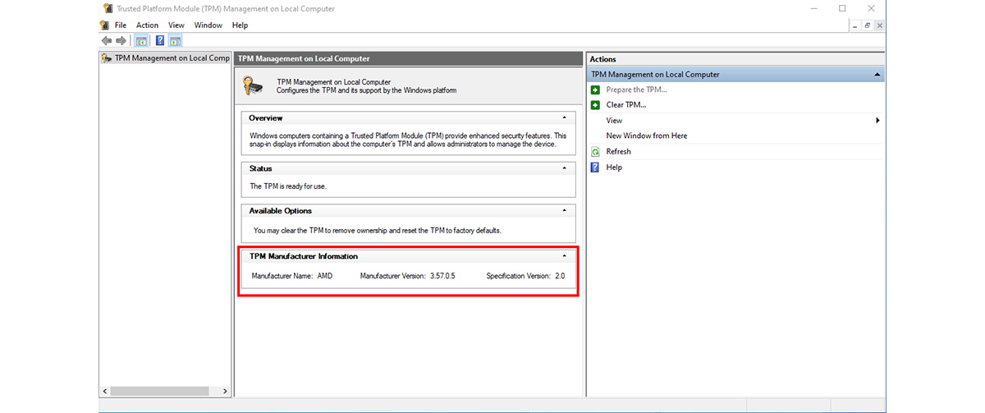
TPM Management Window

Slide 32
Command-Line Tools For TPM and Boot Logs (Demo)
Note*- These commands are intended to be run in Windows PowerShell with administrator privilages.

Slide 33
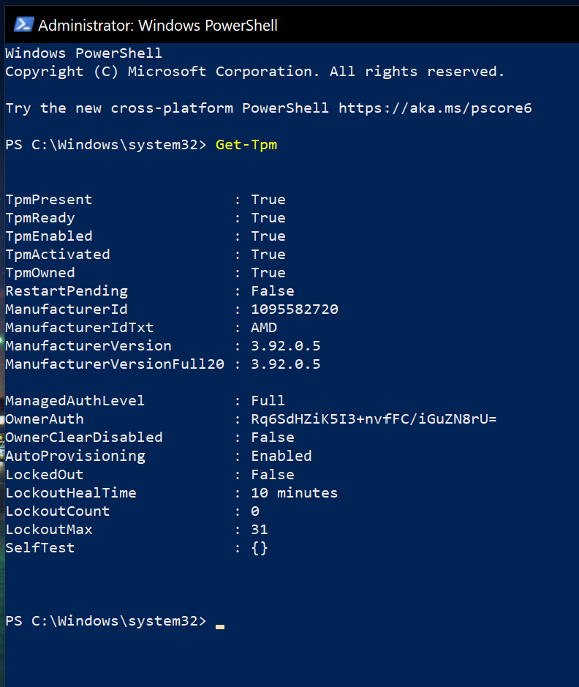
Check TPM Status
Command → Get-Tpm
Purpose - Shows whether TPM is present, enabled, and ready, along with manufacturer and version details.
Example Output:

Slide 34
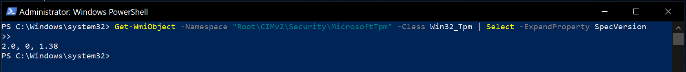
Check TPM Spec Version
Command → Get-WmiObject -Namespace "Root\CIMv2\Security\MicrosoftTpm" -Class Win32_Tpm | Select -ExpandProperty SpecVersion
Purpose - Retrieves the supported TPM specification versions
Example Output:

Slide 35
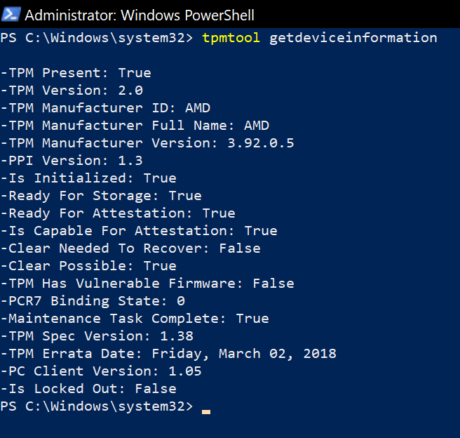
Check TPM Device Information
Command → tpmtool getdeviceinformation
Purpose - Displays detailed TPM hardware information such as manufacturer, version, and readiness status.
Example Output:

Slide 36
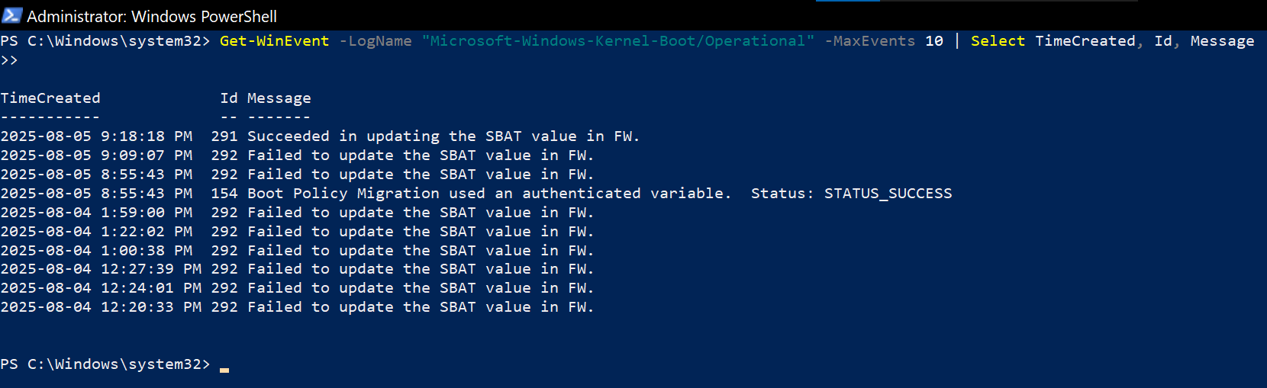
Check Kernel Boot Logs (Measured Boot)
Command → Get-WinEvent -LogName "Microsoft-Windows-Kernel-Boot/Operational" -MaxEvents 10 | Select TimeCreated, Id, Message
Purpose - Provides details about kernel boot events, including ELAM validation and driver loading.
Example Output:

Slide 37
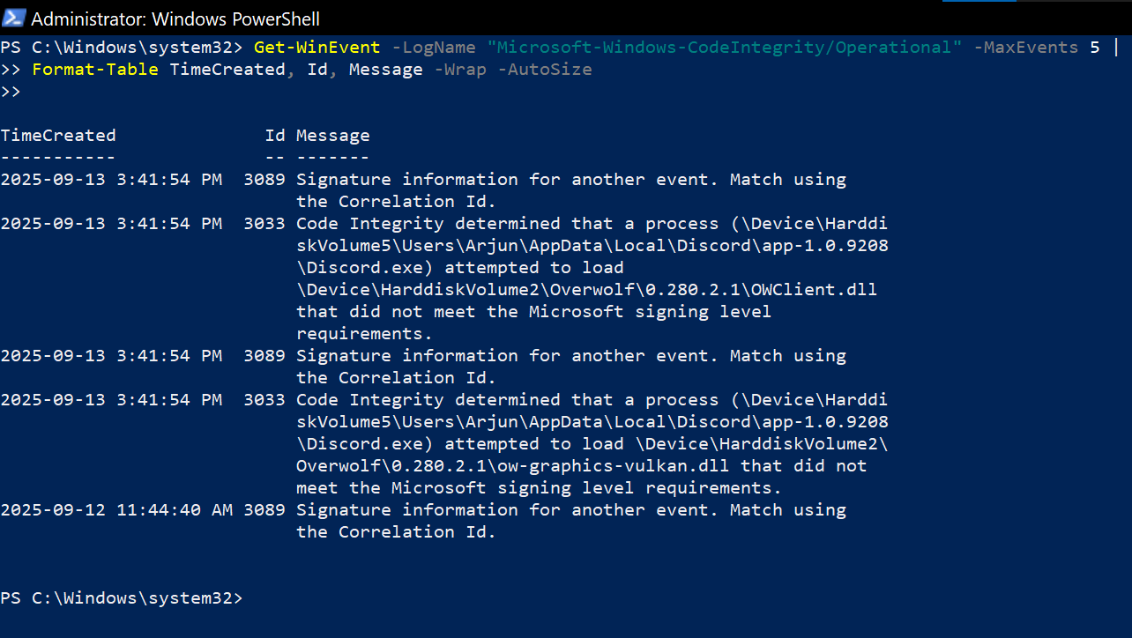
View Trusted Boot Logs (Code Integrity)
Command → Get-WinEvent -LogName "Microsoft-Windows-CodeIntegrity/Operational" -MaxEvents 5 | Select TimeCreated, Id, Message
Purpose - Displays recent code integrity events verifying drivers and system processes during boot.
Example Output:

Slide 38
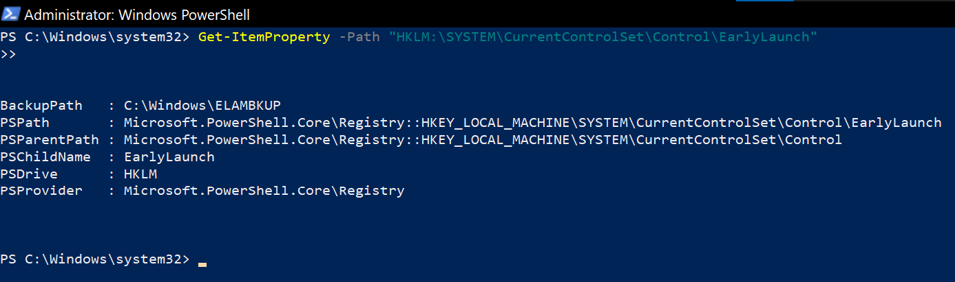
Query ELAM Policy
Command → Get-ItemProperty -Path "HKLM:\SYSTEM\CurrentControlSet\Control\EarlyLaunch"
Purpose - retrieves the configuration settings for Windows' Early Launch Anti-Malware (ELAM) feature, which protects against malware that loads during the boot process
Example Output:

Slide 39
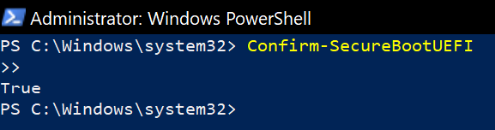
Check Secure Boot Status
Command → Confirm-SecureBootUEFI
Purpose - Returns True if Secure Boot is enabled, False if disabled.
Example Output:

Slide 40
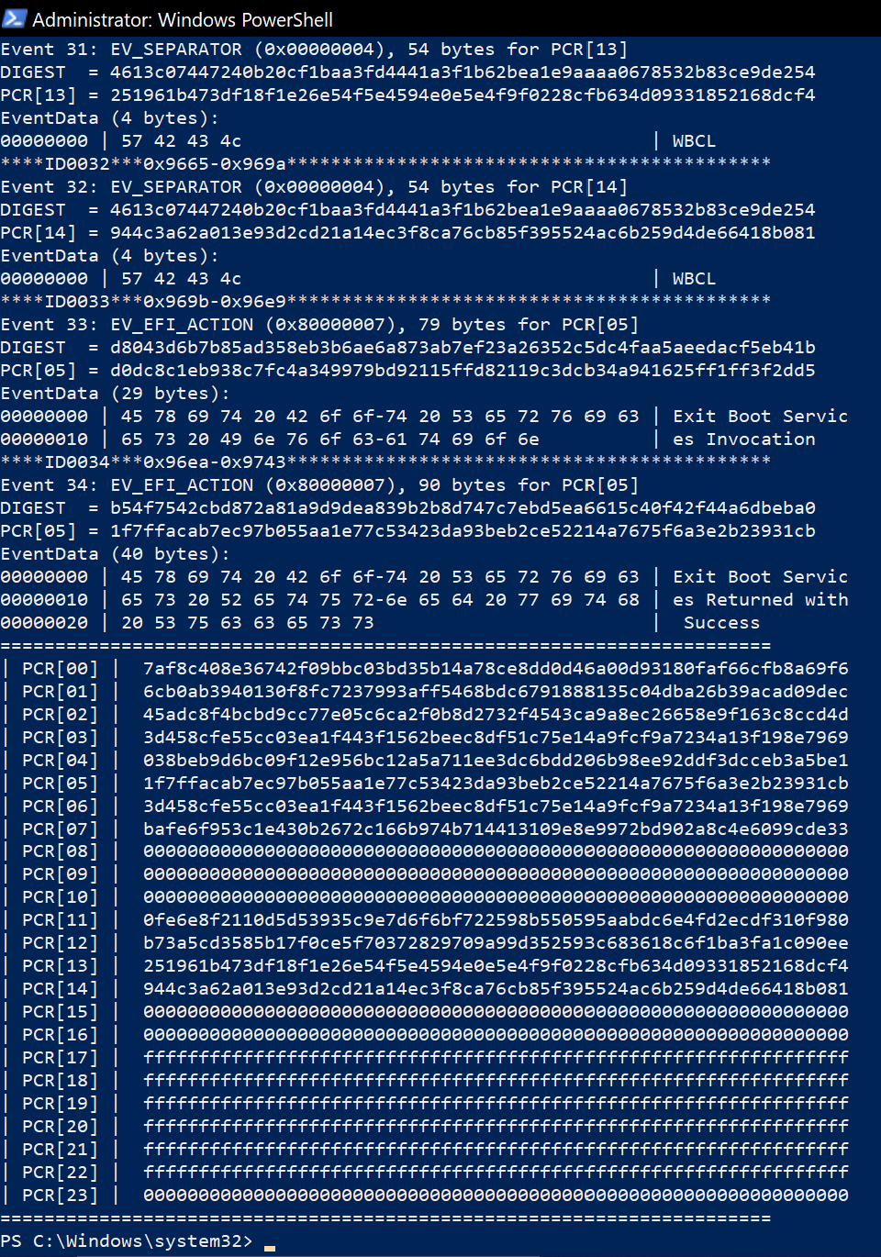
Parsing Measured Boot Logs (Viewing TPM PCR Register Values)
Command → tpmtool parsetcglogs
Purpose - Parses and displays the detailed Measured Boot logs (TCG event logs) from TPM for analyzing PCR values and boot integrity.
Example Output:

Slide 41
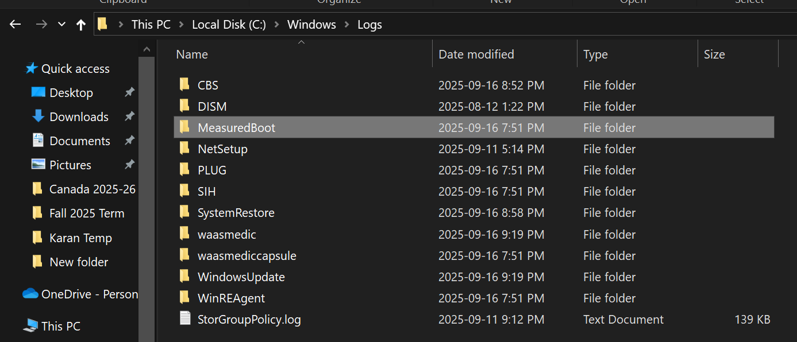
Windows Measured Boot Logs Folder
Path → C:\Windows\Logs\MeasuredBoot
Purpose - The MeasuredBoot log folder contains integrity measurement logs (PCR values, driver verification, boot sequence events) that Windows records for TPM and Trusted Boot attestation..

Slide 42
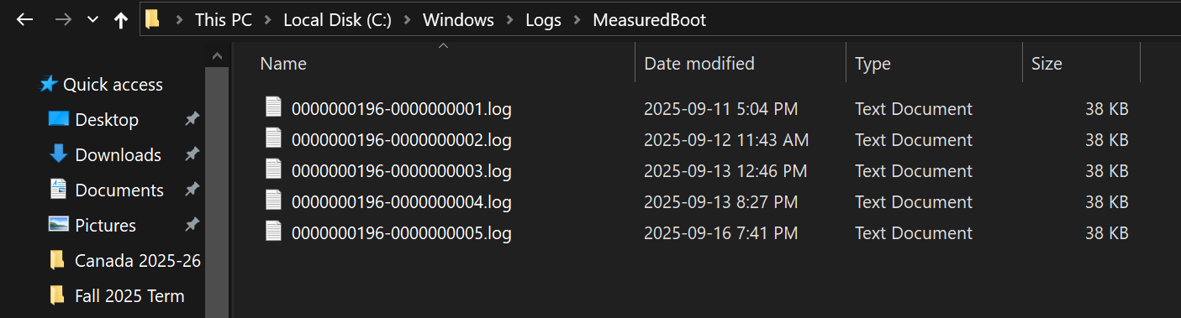
.Log Files (Measured Boot)
Path → C:\Windows\Logs\MeasuredBoot

